Slide 1
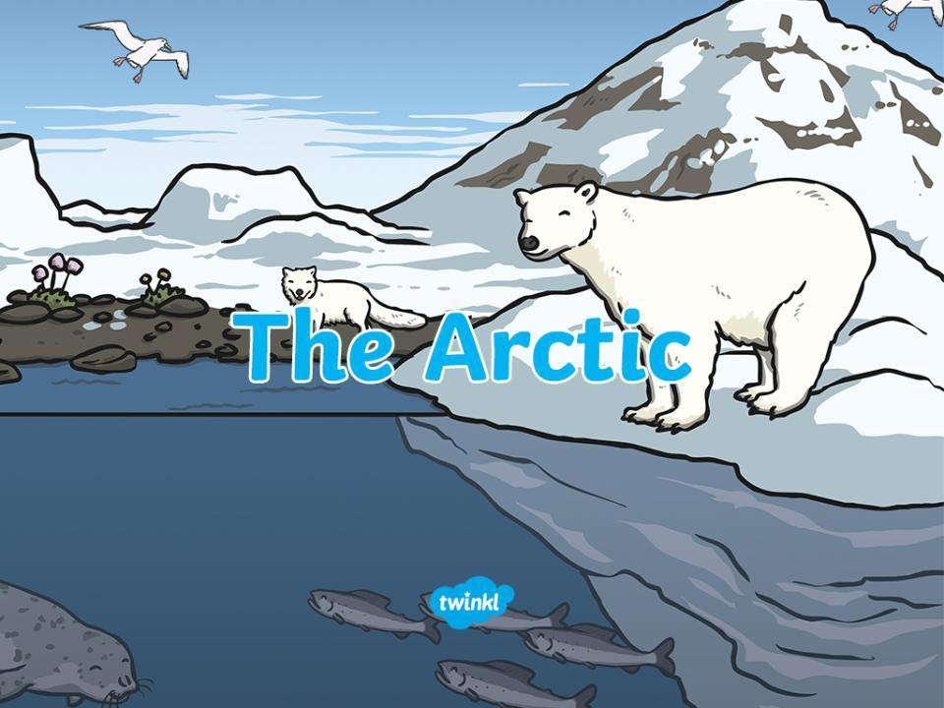

Slide 2


The Arctic is in the Far North.
The North Pole is in the Arctic.
The Arctic has very few plants because it is very cold there.
Why do you think the Arctic is white?
What do you know about the Arctic?
Photo courtesy of NASA Goddard photo and video and dsearls(@flickr.com) -granted under creative commons licence -attributiont

Slide 3

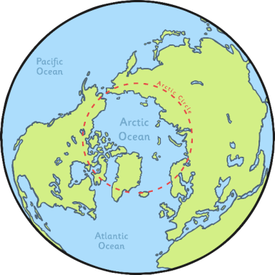
vc
The Arctic is in the Far North.
The ice acts as land.
There are also icebergs in the Arctic Ocean.
Icebergs are pieces of ice which have broken off and are
floating in the ocean.

Slide 4

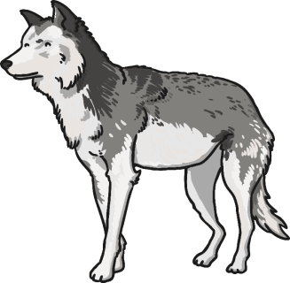
v
Can you think of any animals that live in the Arctic?

Slide 5
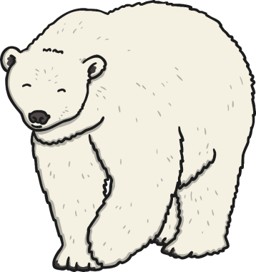
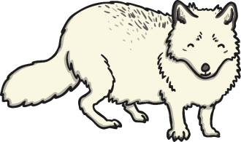
Arctic fox
polar bear
v

Slide 6
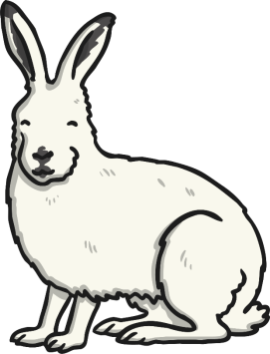
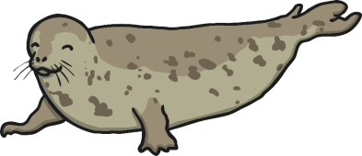
Arctic hare
seal
v

Slide 7
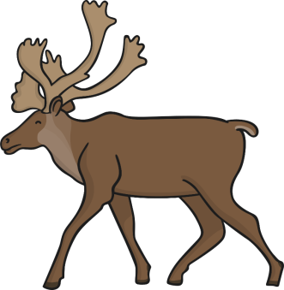
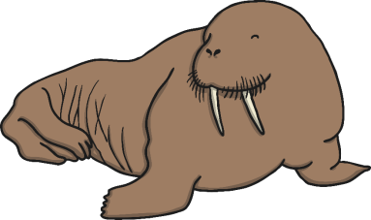
v
reindeer
walrus

Slide 8



v
snowy owl
orca

Slide 9
Do people live in the Arctic?
Houses in the Arctic are often raised from the ground.
This prevents people from being snowed in and helps keep them warm.
Photo courtesy of AntoniO BonivO (@flickr.com) - granted under creative commons licence - attribution

Slide 10
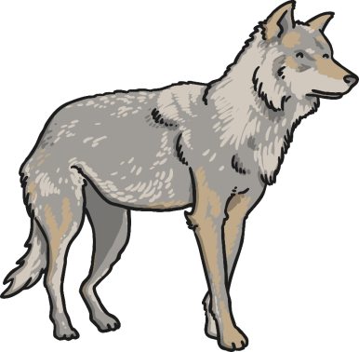
v
Some people travel by dog sled in the Arctic.
Dogs pull the sled which the person stands on. The sled glides along the snow.
People also travel by snowmobile,
which looks like a jet ski on the snow.

Slide 11
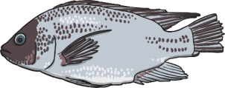
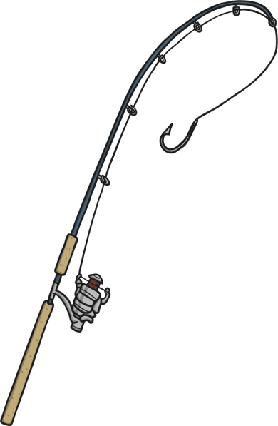
v
Lots of people in the Arctic go ice fishing.
They make a hole in the sea ice and wait for the fish underneath the ice to take the bait.
This is a great way of getting food
in the Arctic.

Slide 12
Scientists often visit the Arctic to try and find new discoveries as there are lots of places that no one has ever been to.
Also, they measure the amount of sea ice. They do this because the world is getting warmer and this is melting sea ice. This could cause lots of problems in the future.
Photo courtesy of NOAA Photo Library (@flickr.com) - granted under creative commons licence - attribution

Slide 13
