Slide 2
Aim
To represent data with objects and drawings and describe the displays.
Success Criteria
I can represent my data using one-to-one correspondence.
I can draw my data into a picture graph.
I can describe my graph by explaining the greatest and smallest number of objects.

Slide 3
What Is Data?
Click to reveal!
quantities
numbers
information
facts
graphs
observations
measurement

Slide 4
Collecting Data
Let’s find out what the most popular fruit in our class is for fruit break.
We are going to use a tally chart to collect the data.
Fruit | Tally | Total

Slide 5
Let’s enter our fruit data collected into a picture graph!
OK!

Slide 6
14
13
12
11
10
9
8
7
6
5
4
3
2
1
Click on a square to add a fruit, and click again to remove it.
When you are finished, click here to continue.

Slide 7
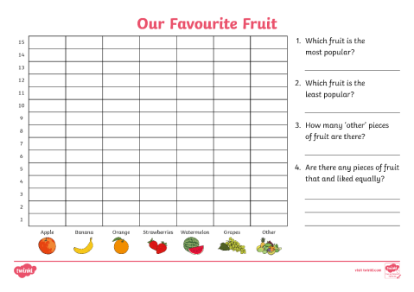
Now It’s Your Turn
Use the data you have collected as a class to fill out your Favourite Fruit Activity Sheet.
Once you have entered your data on the Activity Sheet, answer the questions about your picture graph.

Slide 8
Let’s Share
Share what you have discovered about the data.
What was the most popular fruit? Why?
What was the least popular fruit? Why?
Did you notice anything interesting about your picture graph?
What other topics could the class collect data about?

Slide 9
Aim
To represent data with objects and drawings and describe the displays.
Success Criteria
I can represent my data using one-to-one correspondence.
I can draw my data into a picture graph.
I can describe my graph by explaining the greatest and smallest number of objects.

