Slide 2
1
Question 1
Complete this sentence:
“Pancake Day takes place the day before…”
Christmas Day
Ash Wednesday
Easter Sunday
Next Question

Slide 3
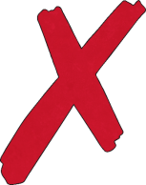
Whoops
The correct answer was…
Ash Wednesday
Next Question

Slide 4
Well Done!
That was the right answer
Well Done!
Next Question

Slide 5
2
Question 2
Which of these is NOT an ingredient in pancake mix?
Milk
Eggs
Yeast
Previous Question
Next
Question

Slide 6
Whoops
The correct answer was…
Yeast
Next Question

Slide 7
Well Done!
That was the right answer
Well Done!
Next Question

Slide 8
3
Question 3
What is another name for Pancake Day?
Shrove Tuesday
Feast
Day
Food
Day
Previous Question
Next
Question

Slide 9
Whoops
The correct answer was…
Shrove Tuesday
Next Question

Slide 10
Well Done!
That was the right answer
Well Done!
Next Question

Slide 11
4
Question 4
Why does Pancake Day happen the day before Lent starts?
In the past, people couldn’t eat eggs during Lent so used them in pancakes.
In the past, people could only eat round foods on the day before Lent.
It’s just a coincidence.
Previous Question
Next
Question

Slide 12
Whoops
The correct answer was…
In the past, people couldn’t eat eggs during Lent so used them in pancakes.
Next Question

Slide 13
Well Done!
That was the right answer
Well Done!
Next Question

Slide 14
5
Question 5
Lent spans the 40 days before which religious festival?
St Patrick’s Day
Christmas Day
Easter Sunday
Previous Question
Next
Question

Slide 15
Whoops
The correct answer was…
Easter Sunday
Next Question

Slide 16
Well Done!
That was the right answer
Well Done!
Next Question

Slide 17
6
Question 6
Which fruit is often squeezed over pancakes?
Mangos
Lemons
Apples
Previous Question
Next
Question

Slide 18
Whoops
The correct answer was…
Lemons
Next Question

Slide 19
Well Done!
That was the right answer
Well Done!
Next Question

Slide 20
7
Question 7
How big was the worlds biggest pancake?
10 meters
5 meters
15 meters
Previous Question
Next
Question

Slide 21
Whoops
The correct answer was…
15 metres
Next Question

Slide 22
Well Done!
That was the right answer
Well Done!
Next Question

Slide 23
8
Question 8
What is Pancake Day called in Sweden?
Fat Tuesday
Greedy Day
The Tuesday Feast
Previous Question
Next
Question

Slide 24
Whoops
The correct answer was…
Fat Tuesday
Next Question

Slide 25
Well Done!
That was the right answer
Well Done!
Next Question

Slide 26
9
Question 9
Complete this sentence:
“During Lent, Christian people often…”
…give something up.
…eat lots of sweets.
…have a big Party.
Previous Question
Next
Question

Slide 27
Whoops
The correct answer was…
…give something up.
Next Question

Slide 28
Well Done!
That was the right answer
Well Done!
Next Question

Slide 29
10
Question 10
How do you cook pancakes?
In a frying pan
In boiling water
In an oven
Previous Question
End Quiz

Slide 30
Whoops
The correct answer was…
In a frying pan
End Quiz

Slide 31
Well Done!
That was the right answer
Well Done!
End Quiz

Slide 32
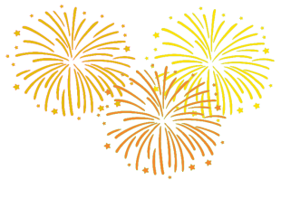
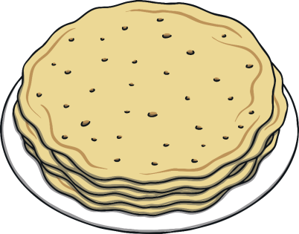
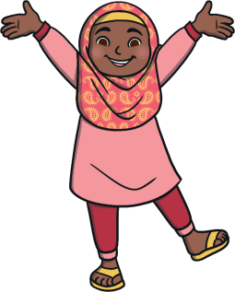
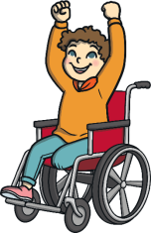
Congratulations!
You finished
the quiz!

