Slide 1
The Giant Panda
Ambassador for All Endangered Animals
By: Anne Jamieson

Slide 2
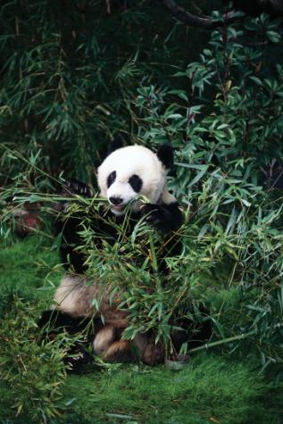
Fast Facts
Height 2.5 Feet at shoulders
Length 5 ft. (with a 6 in. tail)
Weight Around 250 lbs (male) or 220 lbs (females)
Lifespan 20-30 years in captivity.

Slide 3
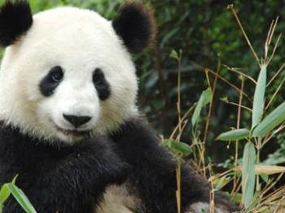
The Giant Panda
Giant pandas have black fur on their ears, around their eyes (eye patches), muzzle, legs, and shoulders.
Notes:
http://www.defenders.org/panda/basic-facts

Slide 4
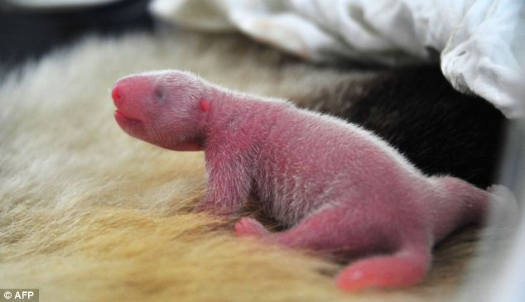
Did You Know?
At birth, panda cubs typically weigh 4-8 oz and measure around 6 inches long!

Slide 5
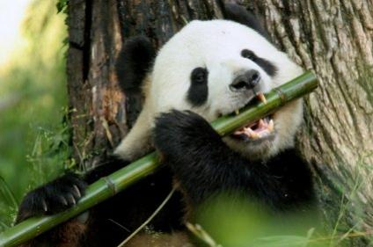
Diet
Pandas eat bamboo. Since giant pandas have the digestive system of a carnivore, they do not have the ability to digest cellulose (plant matter) efficiently and thus derive little energy and little protein from the consumption of bamboo. On occasion, giant pandas are also known to eat flowers, vines, tufted grasses, green corn, honey, and rodents.
The average giant panda has to eat as much as 20 to 45 lbs of bamboo shoots a day!

Slide 6
Behavior
Giant pandas are found mostly in thick bamboo and coniferous forests at 8,500 to 11,500 feet in elevation. They are generally solitary animals that spend most of their days feeding. However, they do communicate with each other once in a while through scent markings, calls, and occasional meetings.

Slide 7
Unlike other bears, giant pandas do not hibernate. In the winter, they move to lower elevations to keep warm, while traveling to higher elevations in the summer to stay cool. They can be active at any time of the day or night.
Pandas do not have permanent homes but sleep at the bottom of trees under stumps or rock ledges.

